Slide 1
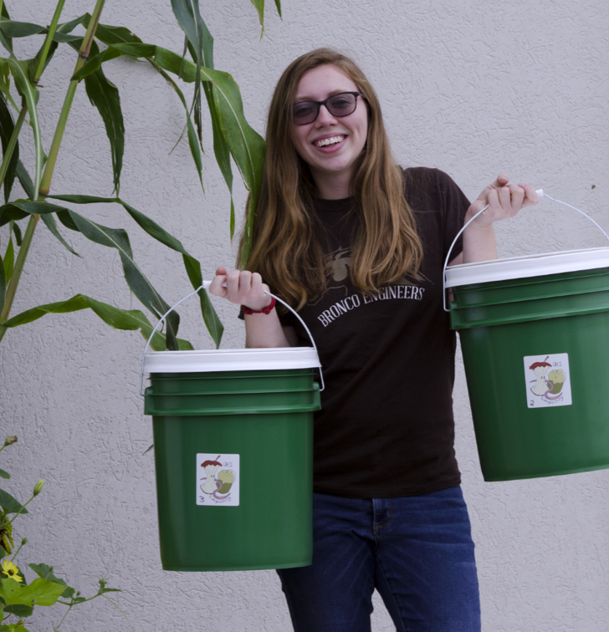

About me: Krystal York
Working towards a PhD in Electrical Engineering
Contact info: krystal.r.york@wmich.edu
Office for Sustainability Project Coordinator
Get involved! Volunteer at the Gibbs House Fridays from 11-3pm
Learn about sustainability! Join my composting workshop March 4th at 4pm via Zoom
Potential breakout session discussions
Composting at WMU
Equitable clean energy for all
Designing for the circular economy
Engineering sustainably

Slide 2
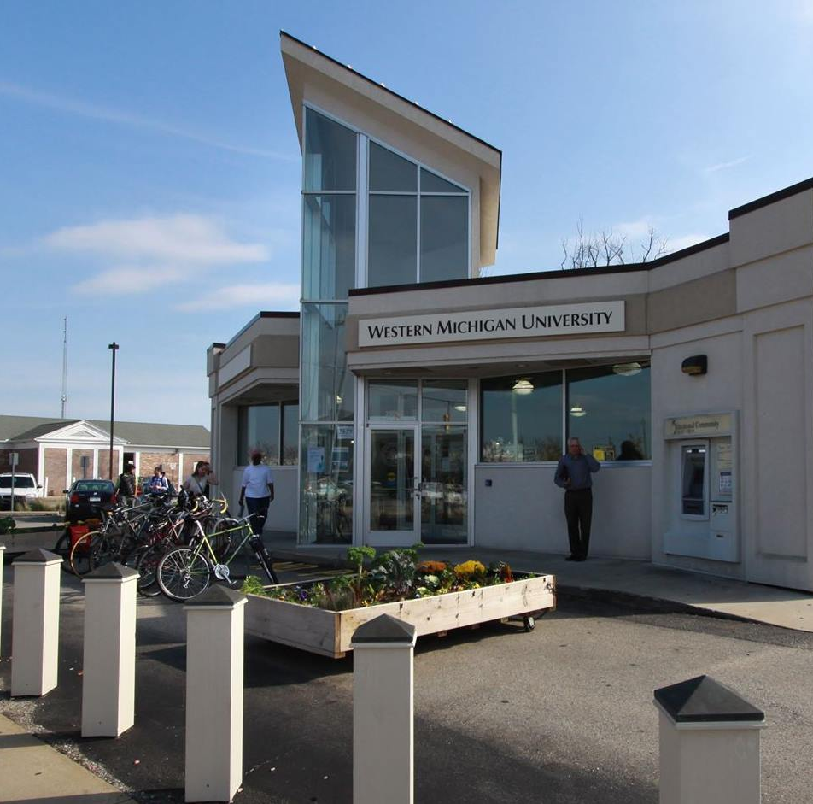
Office for Sustainability
Opportunities at the Office
Volunteer at Gibbs Site: Fridays 11am-3pm https://docs.google.com/forms/d/e/1FAIpQLSe3NrRR-mZE6kn_XGJYY6gcv8QR9BVZmIB8tnLD3PSM2ahn_A/viewform
Open Bike Shop: Fridays 10am-3pm https://docs.google.com/forms/d/e/1FAIpQLSeeeIvQ_fwNF8R2toyUtBsNhNdI5frhkIEbpPJT_a0Ko8uaKQ/viewform
Things you can find at the office: Bike resources, Art Wall, Living Woodshop, Ecoessentials
Bike rental program every semester
Student Sustainability Grants due March 25th, 2021
Workshops: (https://wmich.edu/sustainability/events/workshops)
Composting: March 4th 4pm
Biking Basics: Introduction on March 18th 11:30am Commuting on April 8th noon
Local Sustainability: April 15th noon
How to make Beeswax Wraps: April 22nd 10:30am

Slide 3
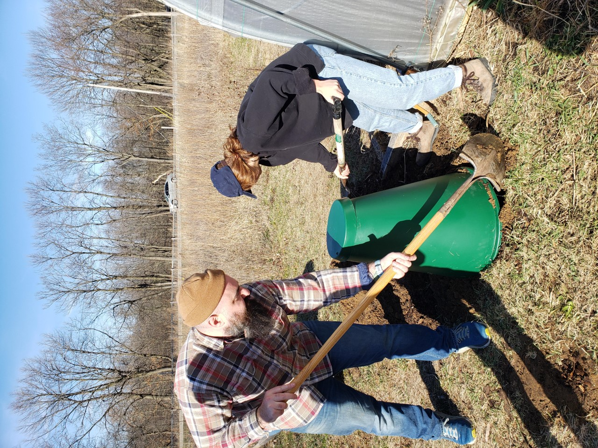
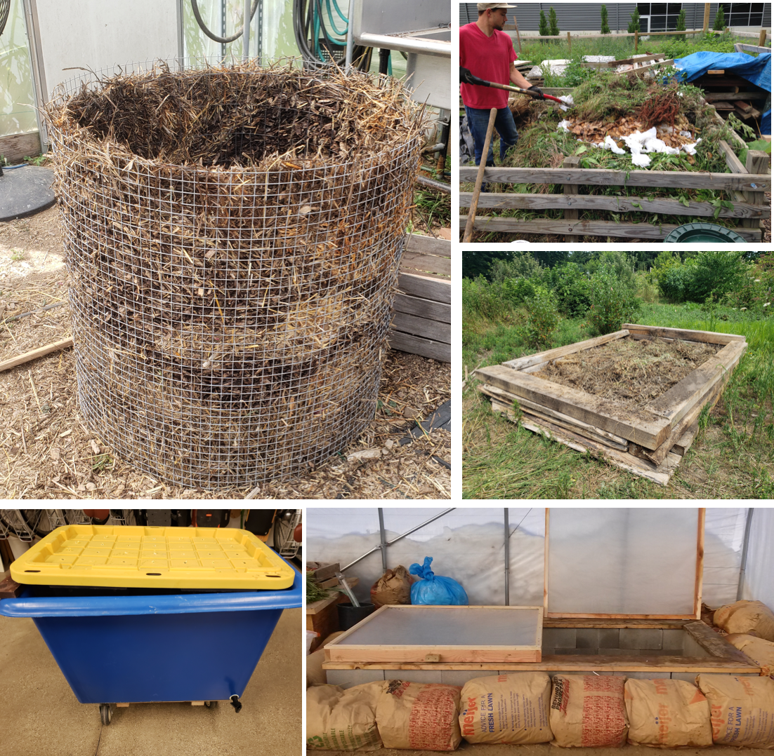

Composting at WMU
Different composting methods:
Vermicomposting
Static pile
Store bought bins
Lasagna beds
Aerated static pile
Collaboration and Outreach
Facilities Management
Landscape Services
Dining Services
Kalamazoo College and KVCC
Campus greenhouse
Farmers Market
Biology Department
Presentations
Bronco Buckets Program (ended)

Slide 4
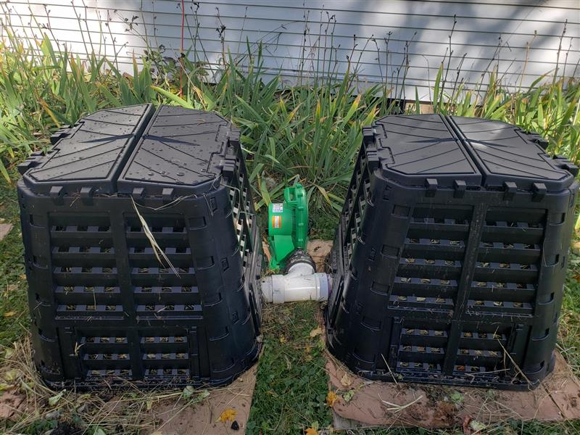
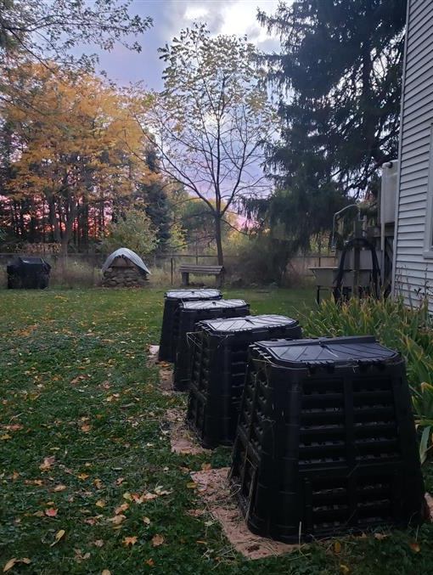
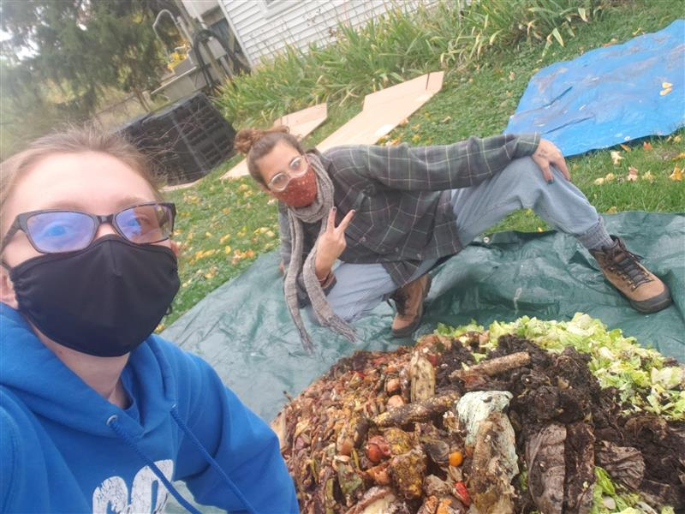
Aerated Static Pile System – Biology Grad Student Project
Collects data for temperature, pH, moisture, oxygen levels, and microbial content
2 bins are aerated static piles and 2 bins are normal static piles
Compares data between all 4 bins

Slide 5
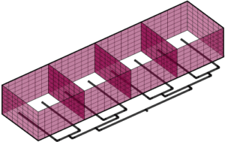
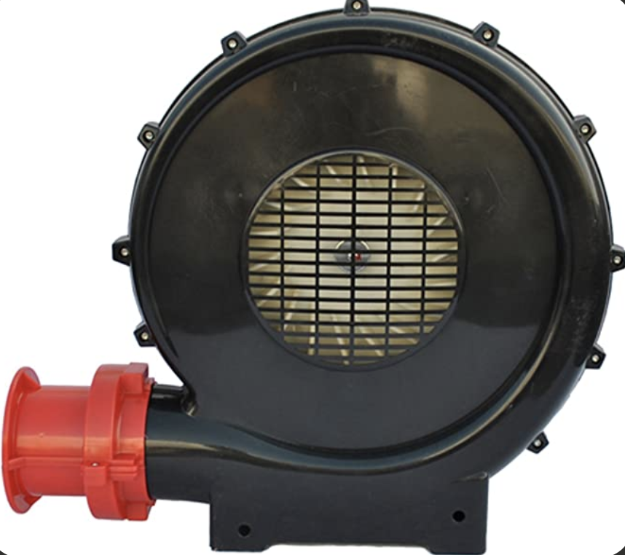
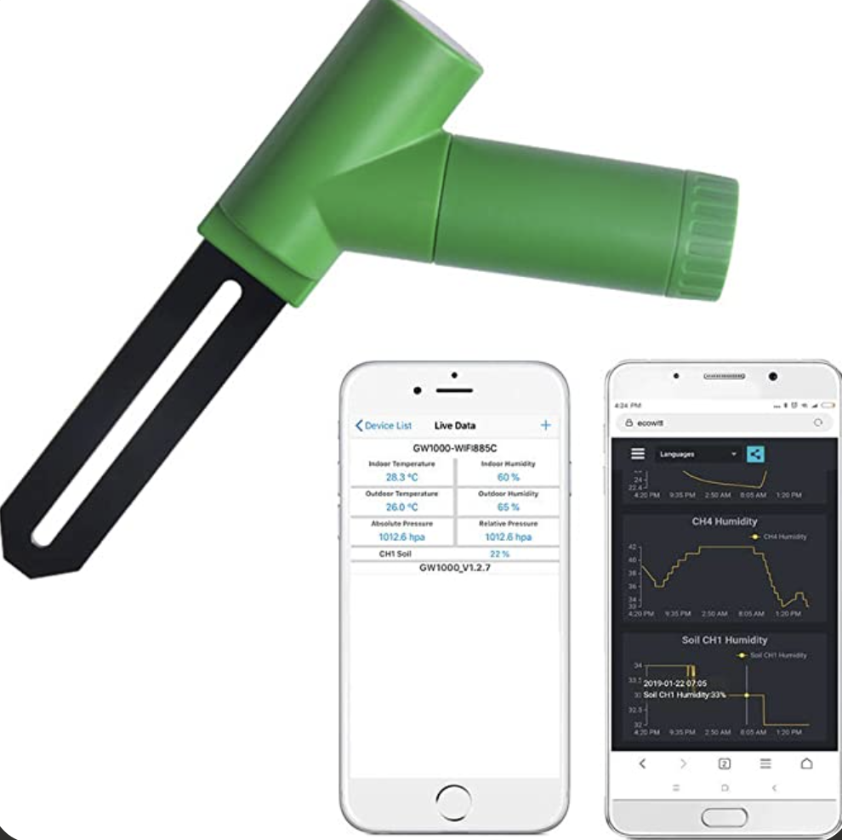
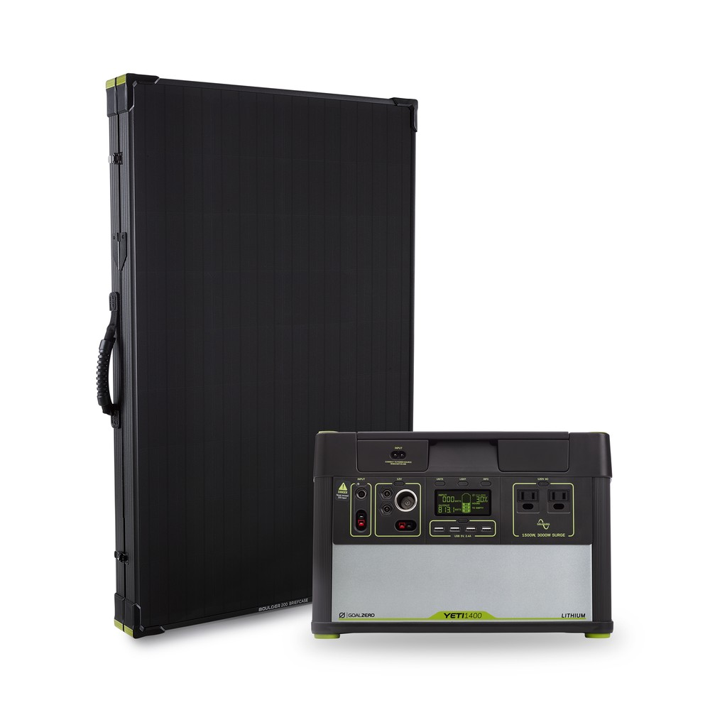

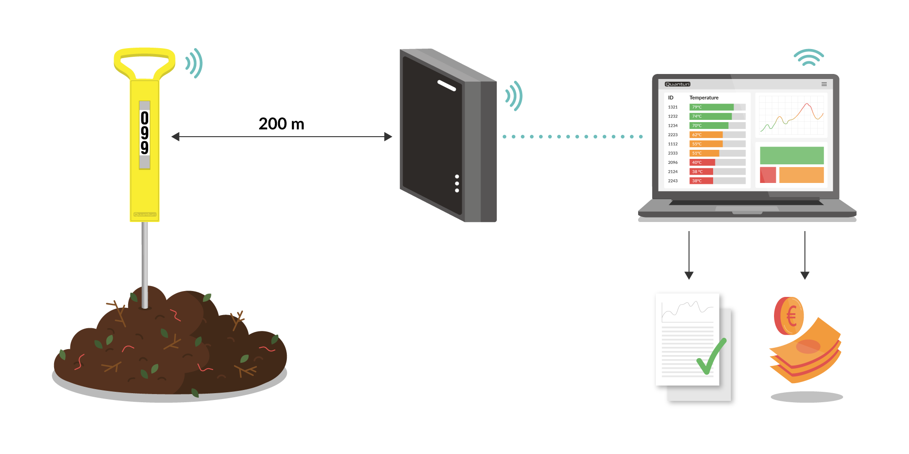
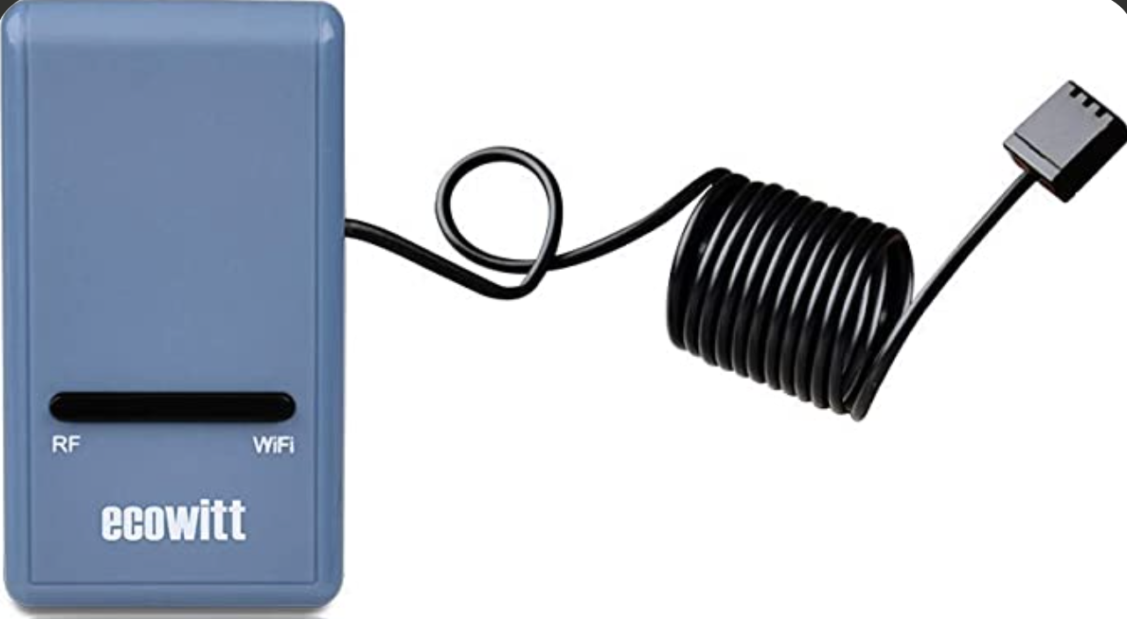
Aerated Static Pile System
Larger system
Funding from the Student Sustainability Grant
Diverting food waste from the VDC
Solar powered
Sensors: temperature, moisture, and pH
Giving compost to landscape services
Moisture Sensor System
Solar Panel and Power Station
Testing soil
Wireless Temperature Sensor System

Slide 6
Equitable clean energy for all
Everyone in the US and abroad
Environmental justice and human rights linked
Consent and input from the local community
Invest in the local community
Good paying, healthy jobs (in every sector)
Update infrastructure
Keep dirty fuels in the ground
Those who contribute the least, face the worst
Righting the wrongs of the past
Affordable, reliable, resilient, accessible, safe
Interesting ideas
Microgrids
Vehicle-to-grid technology
Geothermal, bioenergy, and hydrogen
Agriculture (AgTech) and conservation
Transmission and storage
Updating homes/buildings and housing policy
Data collection and reporting
Smart Devices, Automated emission reduction, and other software ideas
Modeling scenarios
Creative Policies/Regulations?
Making clean energy clean and not destructive
Electrify everything
Mining
Battery design (reuse and recycle minerals)
Solar power? Hydropower? Nuclear?
Thinking of end-of-life
Transportation
Electrify everything
Invest in public transit
Encourage biking
Update infrastructure

Slide 7
Designing for the circular economy
Think about the end-of-life for products in every industry
The fashion industry, textiles, fast fashion
Furniture
Construction (roads, buildings, …)
Appliances (kitchens, washers, dryers, …)
Information and communication technology (ICT) and Electronics
Packaging and plastics
Need product maintenance, repair, reuse, recycling refurbishment & remanufacture, & preservation
Connect people and companies throughout the entire process/life of product
Or one company can keep using their product
Good resource: In the Loop
https://intheloopgame.com/shop/
Interesting ideas
Modular design
Organize takeback and collection
Applying machine learning, AI, or automation to circularity
Creating digital databases and sharing data
Construction – beginning to end
Emotionally durable design
Product buy-back, repair, and resell
Pay-per-use (like leasing, renting, or subscribing)
Making useful products out of waste
Use good, circular materials
Non-toxic
Recyclable
Long-lasting
Biodegradable
Multi-use
Plant-based
Self-healing

